Slide 1
Neuroimaging Detection of mTBI Abnormalities
Christine Mac Donald, PhD
Assistant Professor
Department of Neurological Surgery
University of Washington School of Medicine
Seattle, WA USA

Slide 2
Motivation for Research
Traumatic brain injury (TBI) affects approximately 3.5 million individuals annually in the United States¹ and approximately 75% are due to ‘mild’ or concussive events².
Current clinical and diagnostic tools for assessing concussion are insensitive
Clinical – Glasgow Coma Score - has major limitations obscuring differences among diverse subgroups of TBI patients with very different prognoses^{3,4}.
Diagnostic –CT – Currently only modality recognized by the FDA but well established that head CT is grossly insensitive to concussion pathology.
An objective measure of concussion is lacking
Multi-modal Magnetic Resonance Imaging (MRI) has diagnostic appeal but has yet to be validated for regulatory readiness as a screening tool for concussion.
Prior work has shown that MRI has much greater sensitivity than CT for small, focal traumatic intracranial lesions following brain injury⁵⁻⁹ but what about concussion pathology as a whole?
1. Coronado VG, McGuire LC, Sarmiento K, et al. Trends in Traumatic Brain Injury in the U.S. and the public health response: 1995-2009. Journal of safety research. 2012;43(4):299-307.
Centers for Disease Control and Prevention (CDC) NCfIPaC. Report to Congress on mild traumatic brain injury in the United States: steps to prevent a serious public health problem. Atlanta (GA): Centers for Disease Control and Prevention2003.
Kashluba S, Hanks RA, Casey JE, Millis SR. Neuropsychologic and functional outcome after complicated mild traumatic brain injury. Arch Phys Med Rehabil. 2008;89:904-11.
Iverson GL. Mild traumatic brain injury meta-analyses can obscure individual differences. Brain Inj. 2010;24:1246-55.
Lee H, Wintermark M, Gean AD, Ghajar J, Manley GT, Mukherjee P. Focal lesions in acute mild traumatic brain injury and neurocognitive outcome: CT versus 3T MRI. J Neurotrauma. 2008;25(9):1049-56.
Gentry LR, Godersky JC, Thompson B, Dunn VD. Prospective comparative study of intermediate-field MR and CT in the evaluation of closed head trauma. AJR Am J Roentgenol. 1988;150:673-82.
Jenkins A, Hadley MDM, Teasdale G, Macpherson P, Rowan JO. Brain lesions detected by magnetic resonance imaging in mild and severe head injuries. Lancet. 1986;2(8504):445-6.
Mittl RL, Grossman RI, Hiehle JF, et al. Prevalence of MR evidence of diffuse axonal injury in patients with mild head injury and normal head CT findings. AJNR Am J Neuroradiol. 1994;15:1583-9.
Orrison WW, Gentry LL, Stimac GK, Tarrel RM, Espinosa MC, Cobb LC. Blinded comparison of cranial CT and MRI in closed head injury evaluation. AJNR Am J Neuroradiol. 1994;15:351-6.

Slide 3
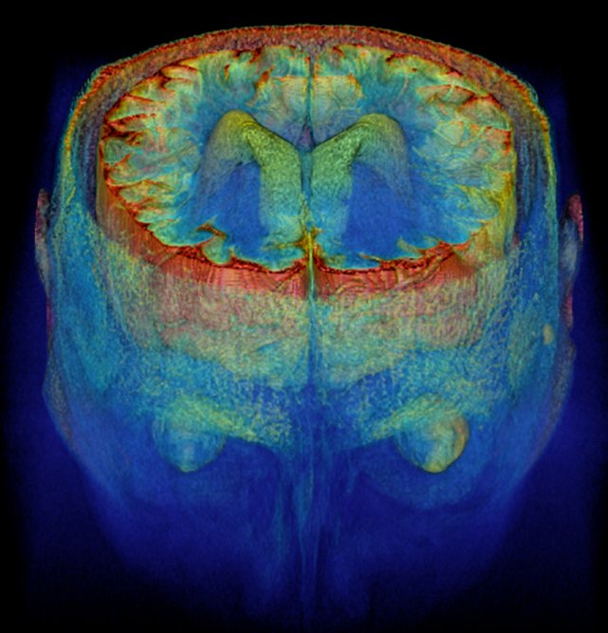
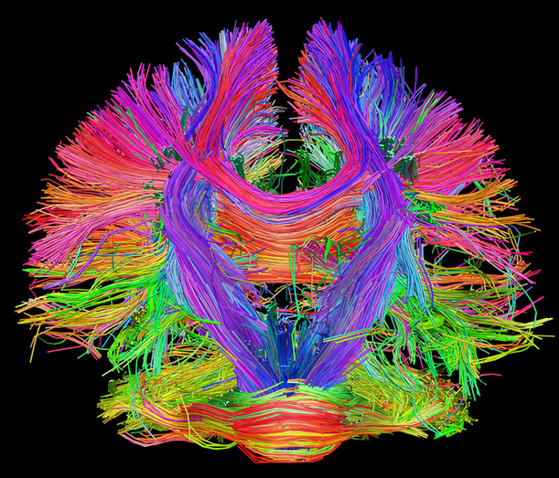
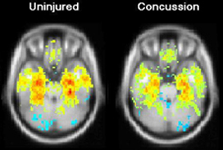
MR Imaging of Concussion
Prior work has shown that approximately one-third of patients presenting to the ED with head injury, but with no head CT findings, have acute trauma-related brain pathology on conventional MRI¹ qualitatively interpreted by a Radiologist.
These findings have been correlated to clinical and functional outcome following concussion¹.
Research with Advanced MR methods has also provided further insight but inconsistencies have been reported in approach, analysis, and findings.
Not just ‘pretty pictures’ – quantitatively informative results
High Resolution Structural Volumetric Imaging
Diffusion Tensor Imaging and Higher Order Models
Resting-State functional MRI and fMRI Methods²
And So On…
Yuh EL, Mukherjee P, Lingsma HF, Yue JK, Ferguson AR, Gordon WA, Valadka AB, Schnyer DM, Okonkwo DO, Maas AI, Manley GT; TRACK-TBI Investigators. Magnetic resonance imaging improves 3-month outcome prediction in mild traumatic brain injury. Ann Neurol. 2013 Feb;73(2):224-35. doi: 10.1002/ana.23783. Epub 2012 Dec 7.
Zhou Y, et al "Default-mode network disruption in mild traumatic brain injury" Radiology 2012; 265: 882-892.

Slide 4
The Challenge
Many were single site studies with no validation across MRI platforms
Group level differences were often reported without showing sensitivity on a single-subject level
For quantitative methods, there had yet to be standardization in acquisition protocol, post-processing pipelines or analytical approach
Little consideration had been given to how to directly compare quantitative data collected from different machines when systematic differences in hardware have been shown to impact these results with varying degrees of significance
With millions of grant dollars spent, we have yet to successfully translate any of these methods into clinical practice reaching our end goal of:
Providing new diagnostic biomarkers for concussion/brain injury

Slide 5
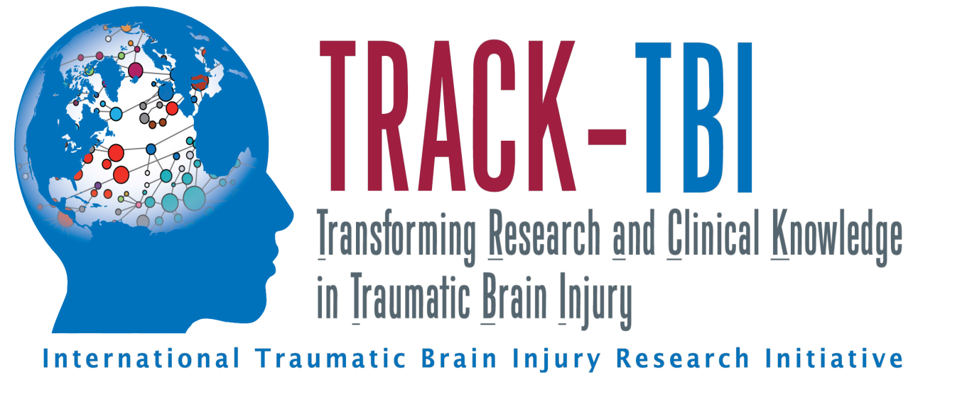
A ‘Big Data’ Approach to Resolving the ‘Small Study’ Problem
New Avenues Towards Successful Translation
Pushing the Field Forward
Current Achievements from TRACK-TBI

Slide 6
How TRACK-TBI Differs from Prior Work
11 site multi-center study working across the G-P-S system of vendors
GE: UCSF, U Cincinnati, UT-Southwestern, U Pitt
Phillips: UW, UT-Southwestern, VCU
Siemens: U Maryland, Harvard/MGH, UCSF, U Pitt, UT Austin, U Miami, VCU, Baylor
First major TBI study to provide a standardized protocol across all platforms for imaging acquisition which includes advanced MRI methods
One of few to complete site qualification and monthly quality assurance methods utilizing three Imaging Phantoms for quantitative combination of data across imaging platforms
ADNI Phantom – Structural Imaging
BIRN Phantom – BOLD (fMRI) Imaging
HPD Phantom – Diffusion Imaging
Providing supportive evidence for feasibility of MR imaging across age spectrum (0-100 years) and injury severity (mild-moderate-severe)
Prior efforts have selected strict inclusion criteria however more often than not, there is high co-morbidity to other disease states with brain injury

Slide 7
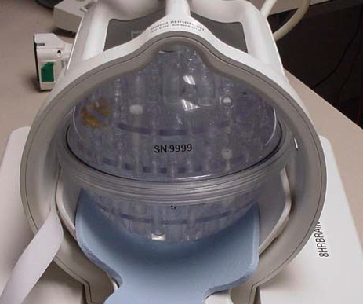
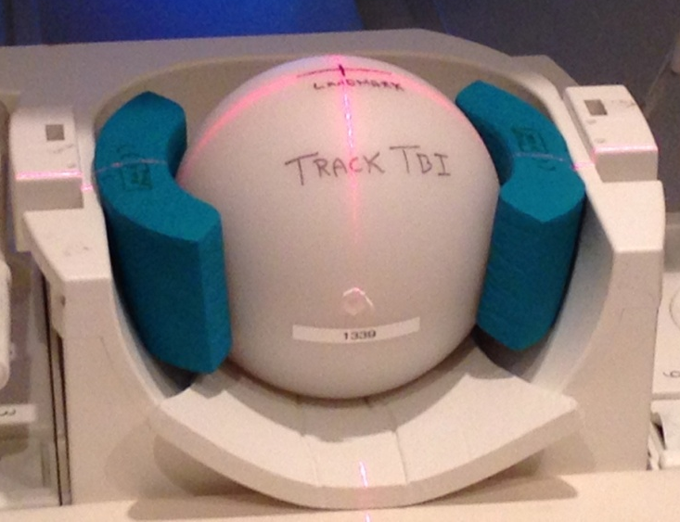
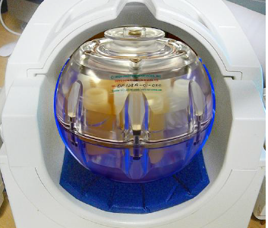
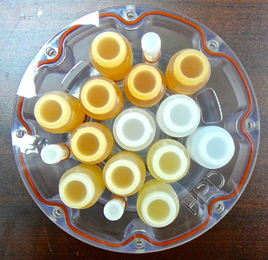
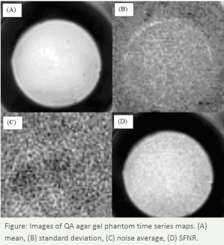
ADNI (Structural)
BIRN (fMRI)
HPD (Diffusion)
Providing a ‘ground truth’ from which to align data

Slide 8
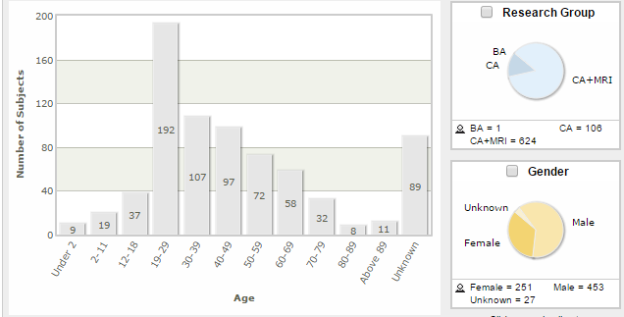
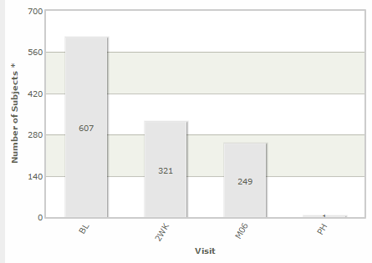
TRACK – TBI Imaging Progress
Queried 22 May 2015

Slide 9
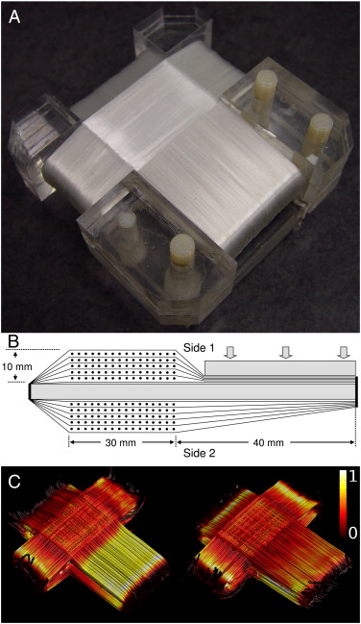
New Challenges arising from New Approach
Data sharing and dissemination
Providing a central repository for ‘big’ imaging data
Average scan 3-500MB, 1000 scans ~ 500TB
Processed data ~2-20TB, 1000 scans ~2-20,000TB! (20 petabytes)
More than what can be handled comfortably on a cloud really at the level of industry multi-server storage
Expedited data transfer from around the world
Supportive evidence from imaging applications in combat
Further development of phantoms and calibration algorithms required for data alignment
Diffusion – Diffusivity to Anisotropy or Hybrid of both
Utilization of current data to optimize post-processing pipelines
Diffusion Tensor Phantom
Farrher E, Kaffanke J, Celik AA, Stöcker T, Grinberg F, Shah NJ. Novel multisection design of anisotropic diffusion phantoms. Magn Reson Imaging. 2012 May;30(4):518-26

Slide 10
Mild Brain Injury Patient
(Same Data -Different Pipelines)
Pipeline A
Pipeline B
*Images have been windowed slightly overexposed to highlight discrepancies

Slide 11
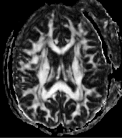
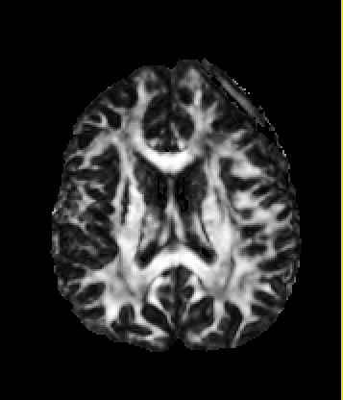
Severe Brain Injury Patient
(Same Data -Different Pipelines)
Pipeline C
Pipeline B

Slide 12
Moving Forward
http://www.cloudcomputing-news.net/media/img/news/iStock_2015_2.jpg.800x600_q96.png

Slide 13
Next Steps
Show clinical utility across all imaging platforms
Dissemination to the masses
‘Big data’ studies for validation (TRACK-TBI, CENTER-TBI, etc)
Explore opportunities for further collaboration and combination of existing data
Design and refinement of phantoms, calibration algorithms
Standardization of quantitative post-processing pipelines
Direct application and translation of imaging methods to other neurodegenerative disease states
Parkinson's
Alzheimer's Disease
ALS
Multiple Sclerosis
……

Slide 14
Successful Translation - End Goals
Provide more sensitive tools for:
Diagnosis
Rehabilitation
Stratification for Therapeutic intervention/Drug development
Reconsideration to previously ‘failed’ drug trials?
Were previous results influenced by crude stratification measures?
CT scan negative for control may not have been a control (?)
Lower GCS for TBI may have been for other concomitant medical issues not a real TBI (?)
Remember: How will this help the patient
Provide more definitive evidence for disability claims
Who is really in need and who is just looking for $$$
Provide further piece of mind about underlying condition even in the absence of injury resolution
Notes:
Close by telling briefly the story of patient C.B. to emphasize the importance of new imaging methods

Slide 15
Thank you!
Follow up comments/questions can be directed to: cmacd@uw.edu

